Slide 1
11) Common Good
Concern and well being for all people

Slide 2
12) Communion of Saints
Union of believers, living and dead, who form one body of Christ

Slide 3
13) Conception
The moment that life begins

Slide 4
14) Conscience
An inner voice allowing one to choose what is right or wrong

Slide 5
15) Covenant
A promise between God and His people (examples: Moses and
Noah)

Slide 6
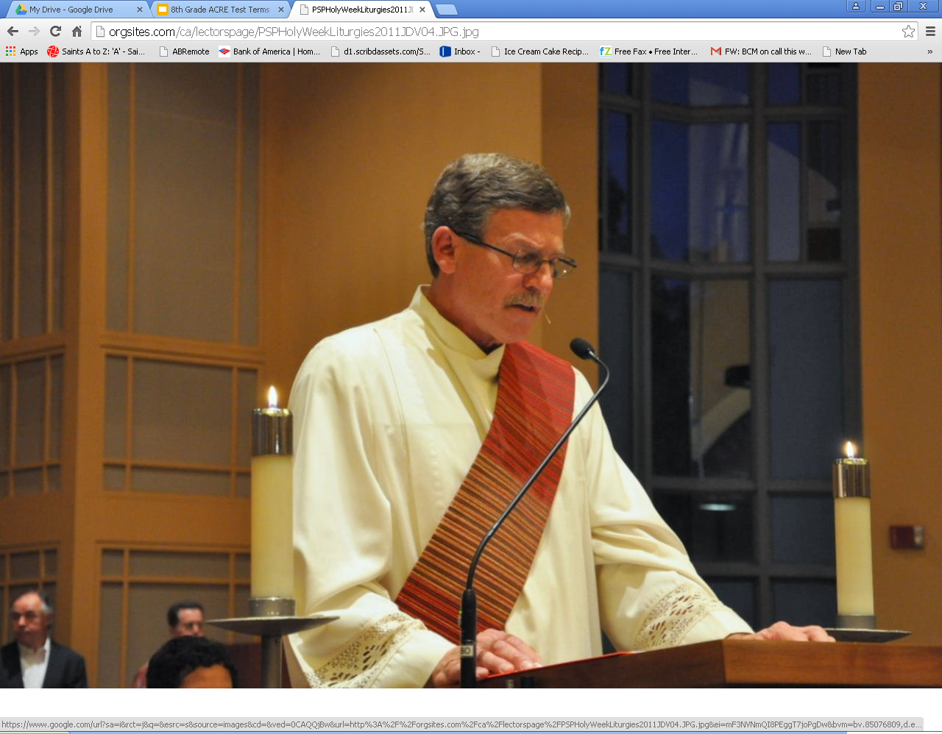
16) Deacon
Serves during the liturgy by proclaiming the Gospel

Slide 7
18) Ecumenism
Movement towards unity among Christians and Christian churches

Slide 8
18) Evangelize:
To share the Good News of Jesus Christ (Gospels) with others - Go and make disciples of all nations.

Slide 9
19) Genesis
The first book of the Old Testament that contains creation stories.

Slide 10
20) Great Commandment
Love the Lord God above all. Love your neighbor
as yourself.

