Slide 1
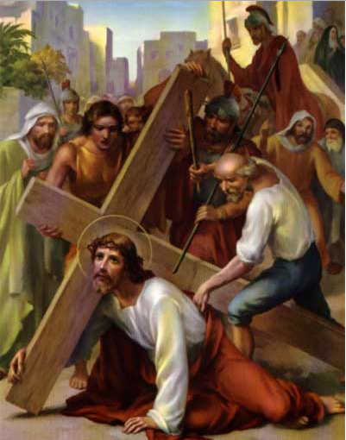
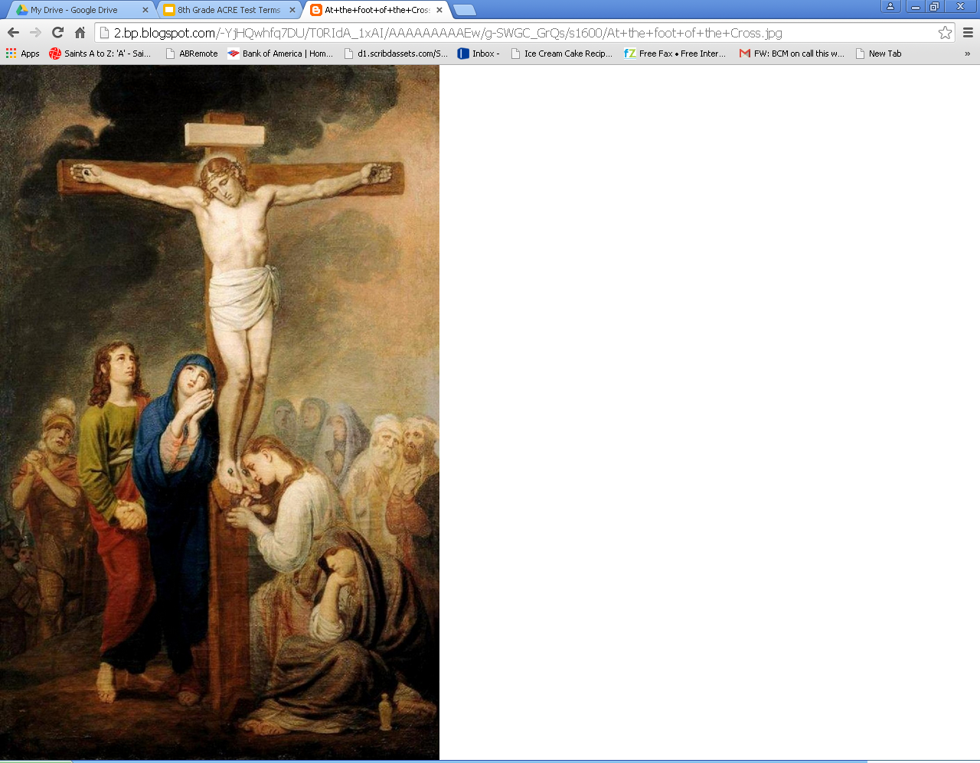
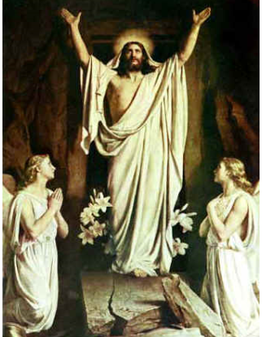
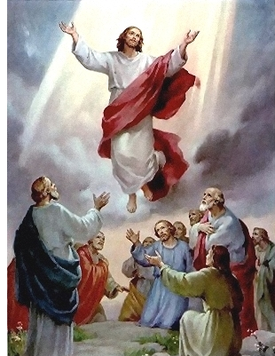
31) Paschal Mystery
The work of salvation accomplished by Jesus’ suffering, death, resurrection and ascension. It is
celebrated in the liturgy of the church, and its saving effects are experienced by us in the sacraments.

Slide 2
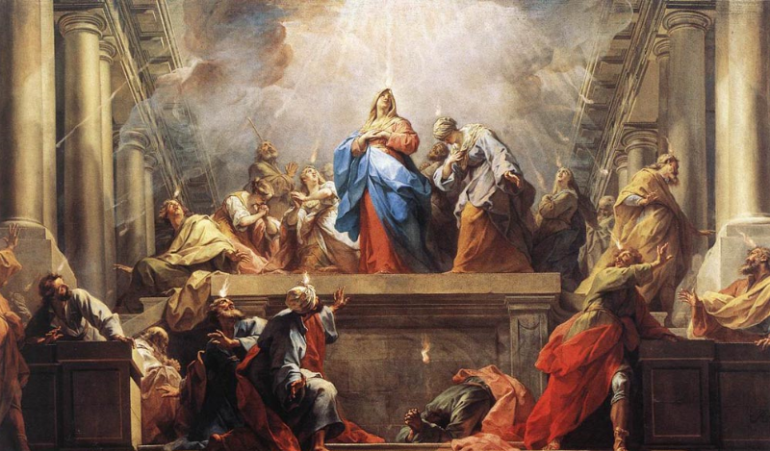
32) Pentecost
The day Christians celebrate the coming of the Holy Spirit to the disciples.

Slide 3
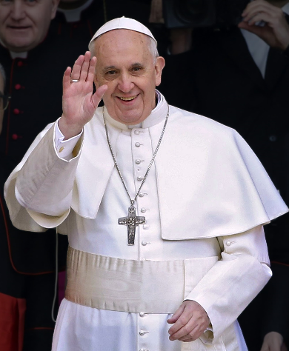
33) Pope
The leader of the Catholic Church throughout
the world. The highest teaching
authority along with the bishops.

Slide 4
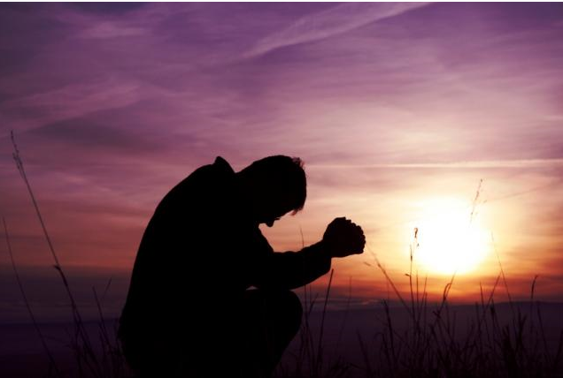
34) Prayer
Raising one’s mind and heart to God and by doing so receiving God’s grace and strength.

Slide 5
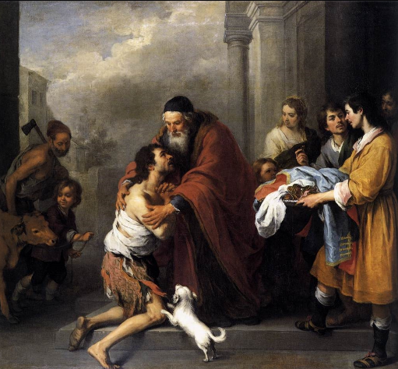
35) Prodigal Son
A story of forgiveness. The father was filled with joy upon seeing his son return home.

Slide 6
36) Resurrection
Jesus’ rising from the dead after He was crucified.
It confirms what Jesus taught
about himself and the Kingdom
of Heaven.

Slide 7
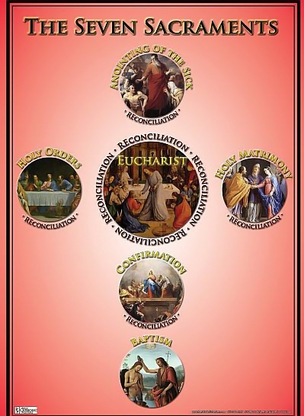
37) Sacraments
Signs of God’s grace and love. Christ’s acting through the Church that transforms us.

Slide 8
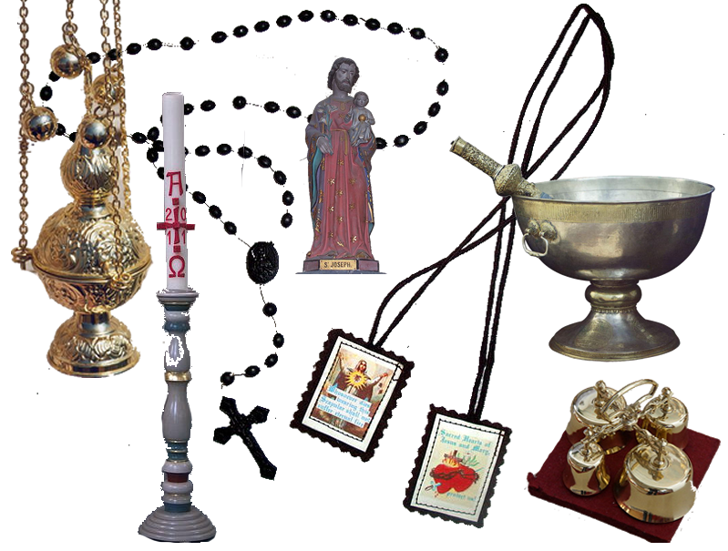
38) Sacramentals
Objects, actions, and blessings that help us grow in holiness

Slide 9
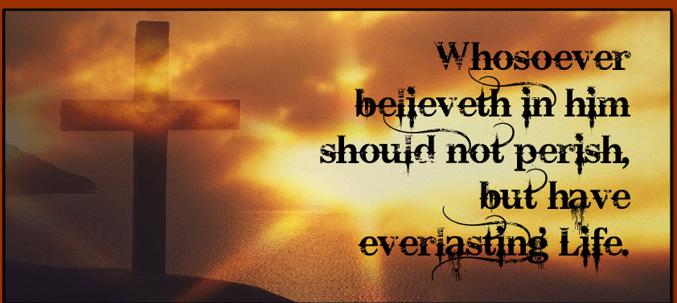
39) Salvation
The act of saving men from their separation from God, what Jesus through His Death and Resurrection offered to all people.

Slide 10
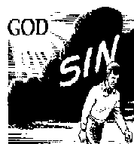
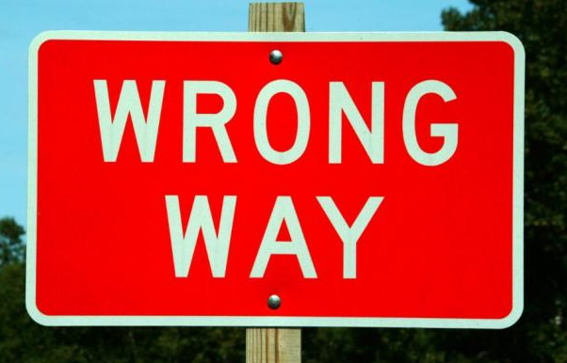
40) Sin
A turning away from God; an action contrary to God’s law.

Slide 11
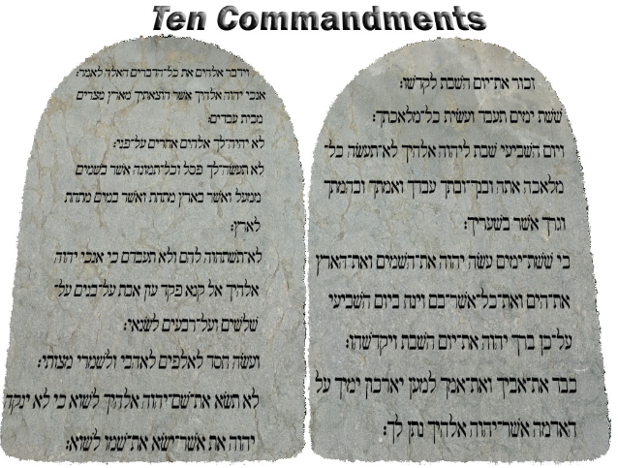
41) Ten Commandments
The moral law given to Moses on Mount Sinai.The first 3 tell us how to love God. The final 7 tell us how to love our neighbor.

Slide 12
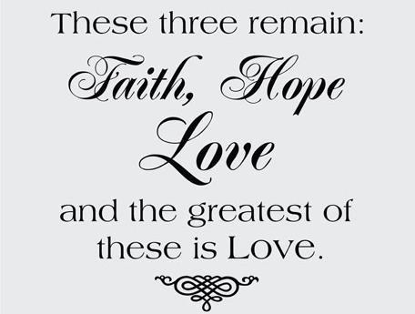
42) Theological Virtues
Virtues given by God: faith, hope, and charity

