Slide 1
Back-to-School Night GRADE 5
2016-2017
St. Gregory the Great
Teacher: Mrs. Brown

Slide 2
Agenda
Meet the teacher
Receive Important Information
Check Out Our Classroom
Get Ready for a Great Year!

Slide 3
My Goals
To provide a safe, positive, and nurturing learning environment for your child.
To assist your child in reaching his/her highest potential.
To encourage and support them in reaching their goals!

Slide 4
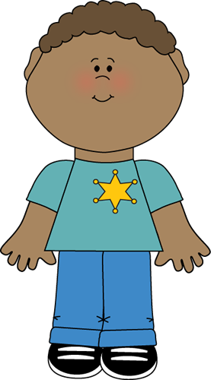
Student Goal:
To learn and to interact in a positive considerate manner
Self-monitor behavior
Make good choices

Slide 5
Classroom Community
Our classroom rules are:
Respect others, respect yourself, respect the school
Follow directions
Be safe
Be honest
Make “good” choices

Slide 6
Class Subjects
The subjects we cover in
Grade 5 are:
Reading and Writing
Math
Religion
Social Studies
Art
Computers
Science *Mrs. Romo
Music *Mr. Hammerbacher
P.E. *Mr. Padilla

Slide 7
Reading
California Treasures Macmillan/ McGraw-Hill Reading Series.
Accelerated Reader program *
Acellus Program *

Slide 8
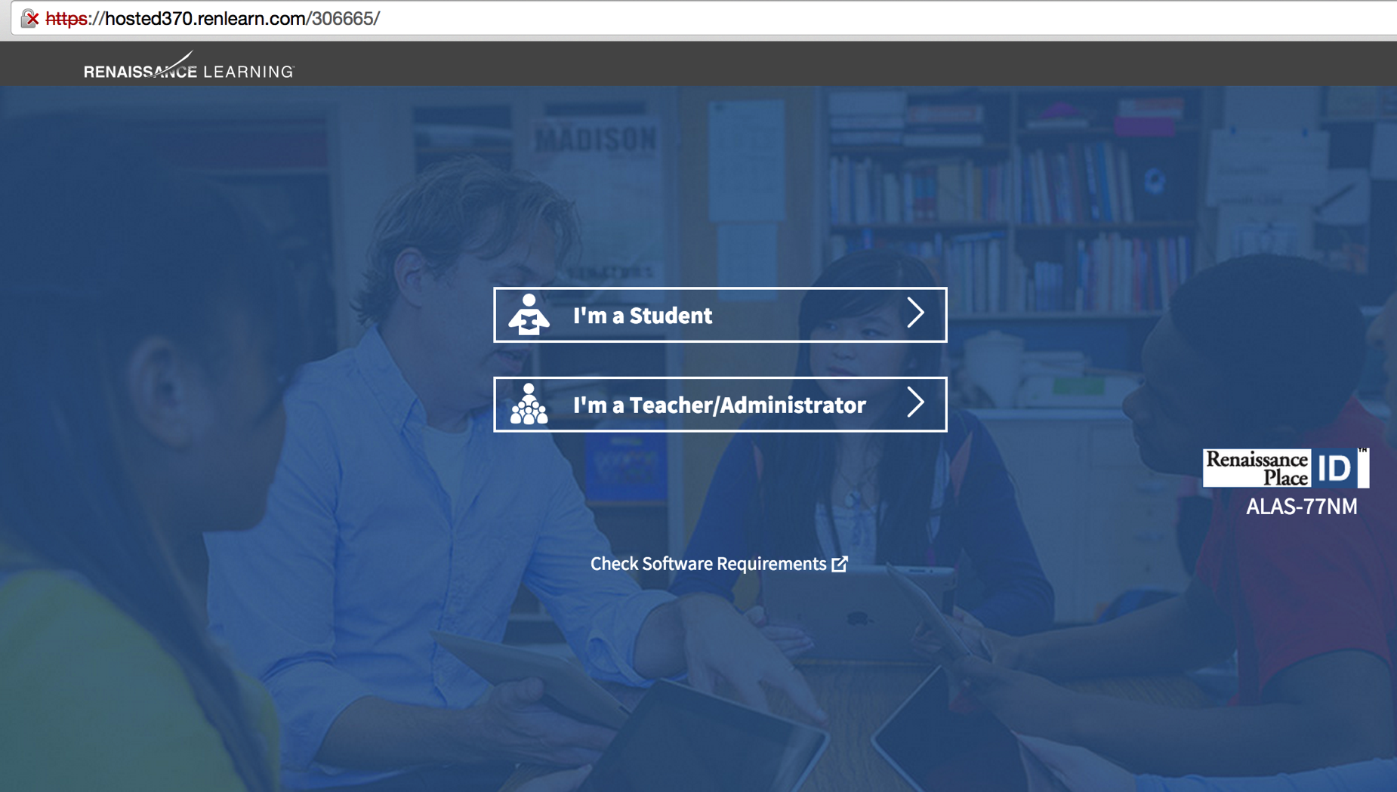
Accelerated Reader

Slide 9
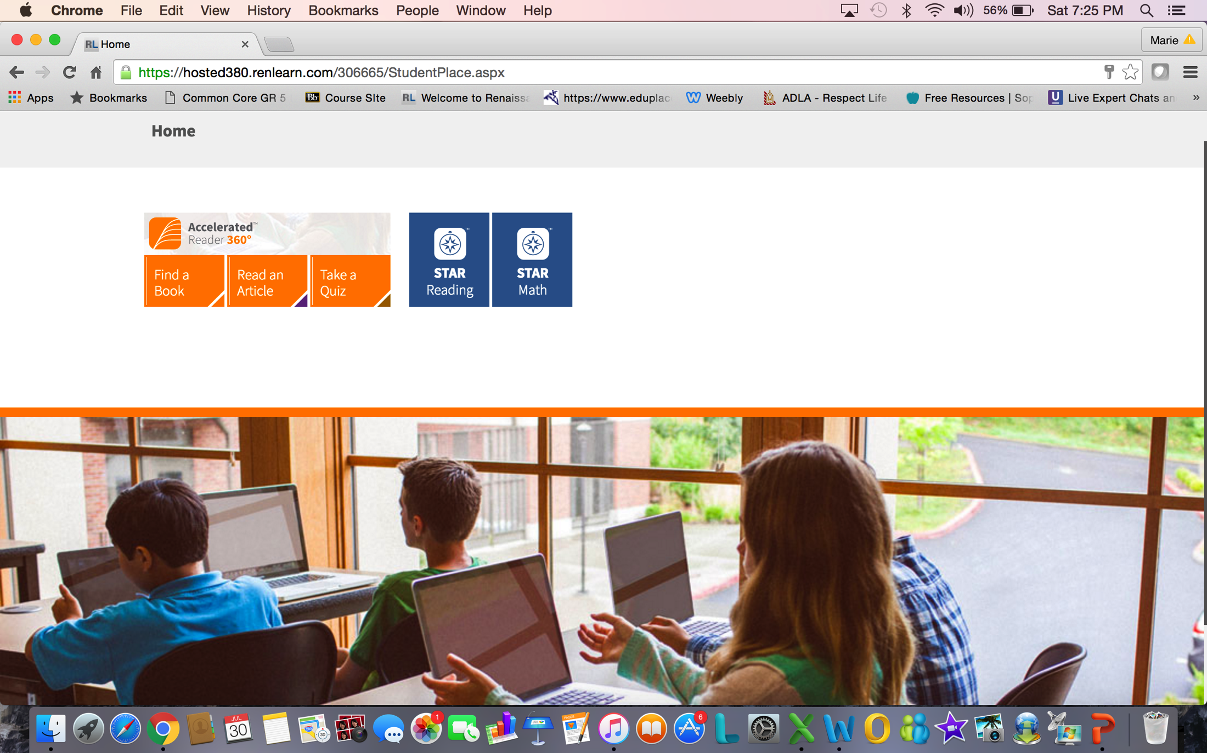
Accelerated Reader
https://hosted380.renlearn.com/306665/

Slide 10
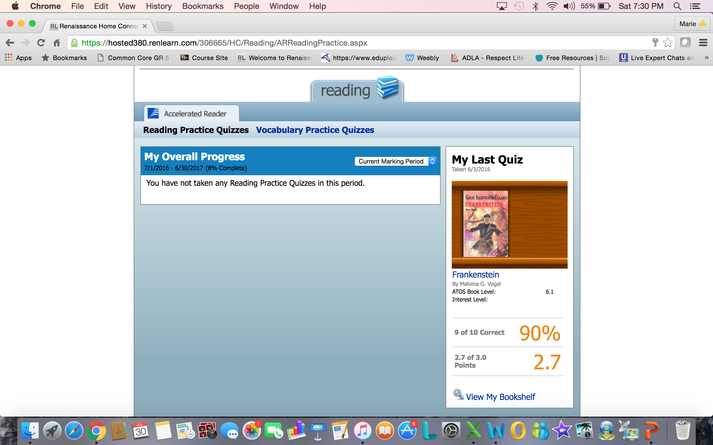
https://hosted380.renlearn.com/306665/HomeConnect/Login.aspx

Slide 12
