Slide 1
Math
Houghton Mifflin –Harcourt California Math
Acellus Program*

Slide 2
Oral and Written Language
California Treasures Macmillan/ McGraw-Hill Reading Series.
Writing/Grammar/Spelling
Acellus Program*
Accelerated Reader*

Slide 3
Homework
Beginning this week homework will be assigned.☺
Combination of Language Arts and Math. (regularly)
Read for 20 Minutes every night.
-Record in Reading Log.
Social Studies and Religion
-(as applies)

Slide 4
About Food
Bring a snack for Recess
(10:00-10:15) If you decide to bring $ there
are vending machines *
Lunch
(12:00-12:45)
Hot Lunch is available
for purchase (*Sept.)
Monday-Thursday.

Slide 5
Websites
School Website *
Class Website *
Gradelink Program *
Acellus Program*
Accelerated Reader*

Slide 6
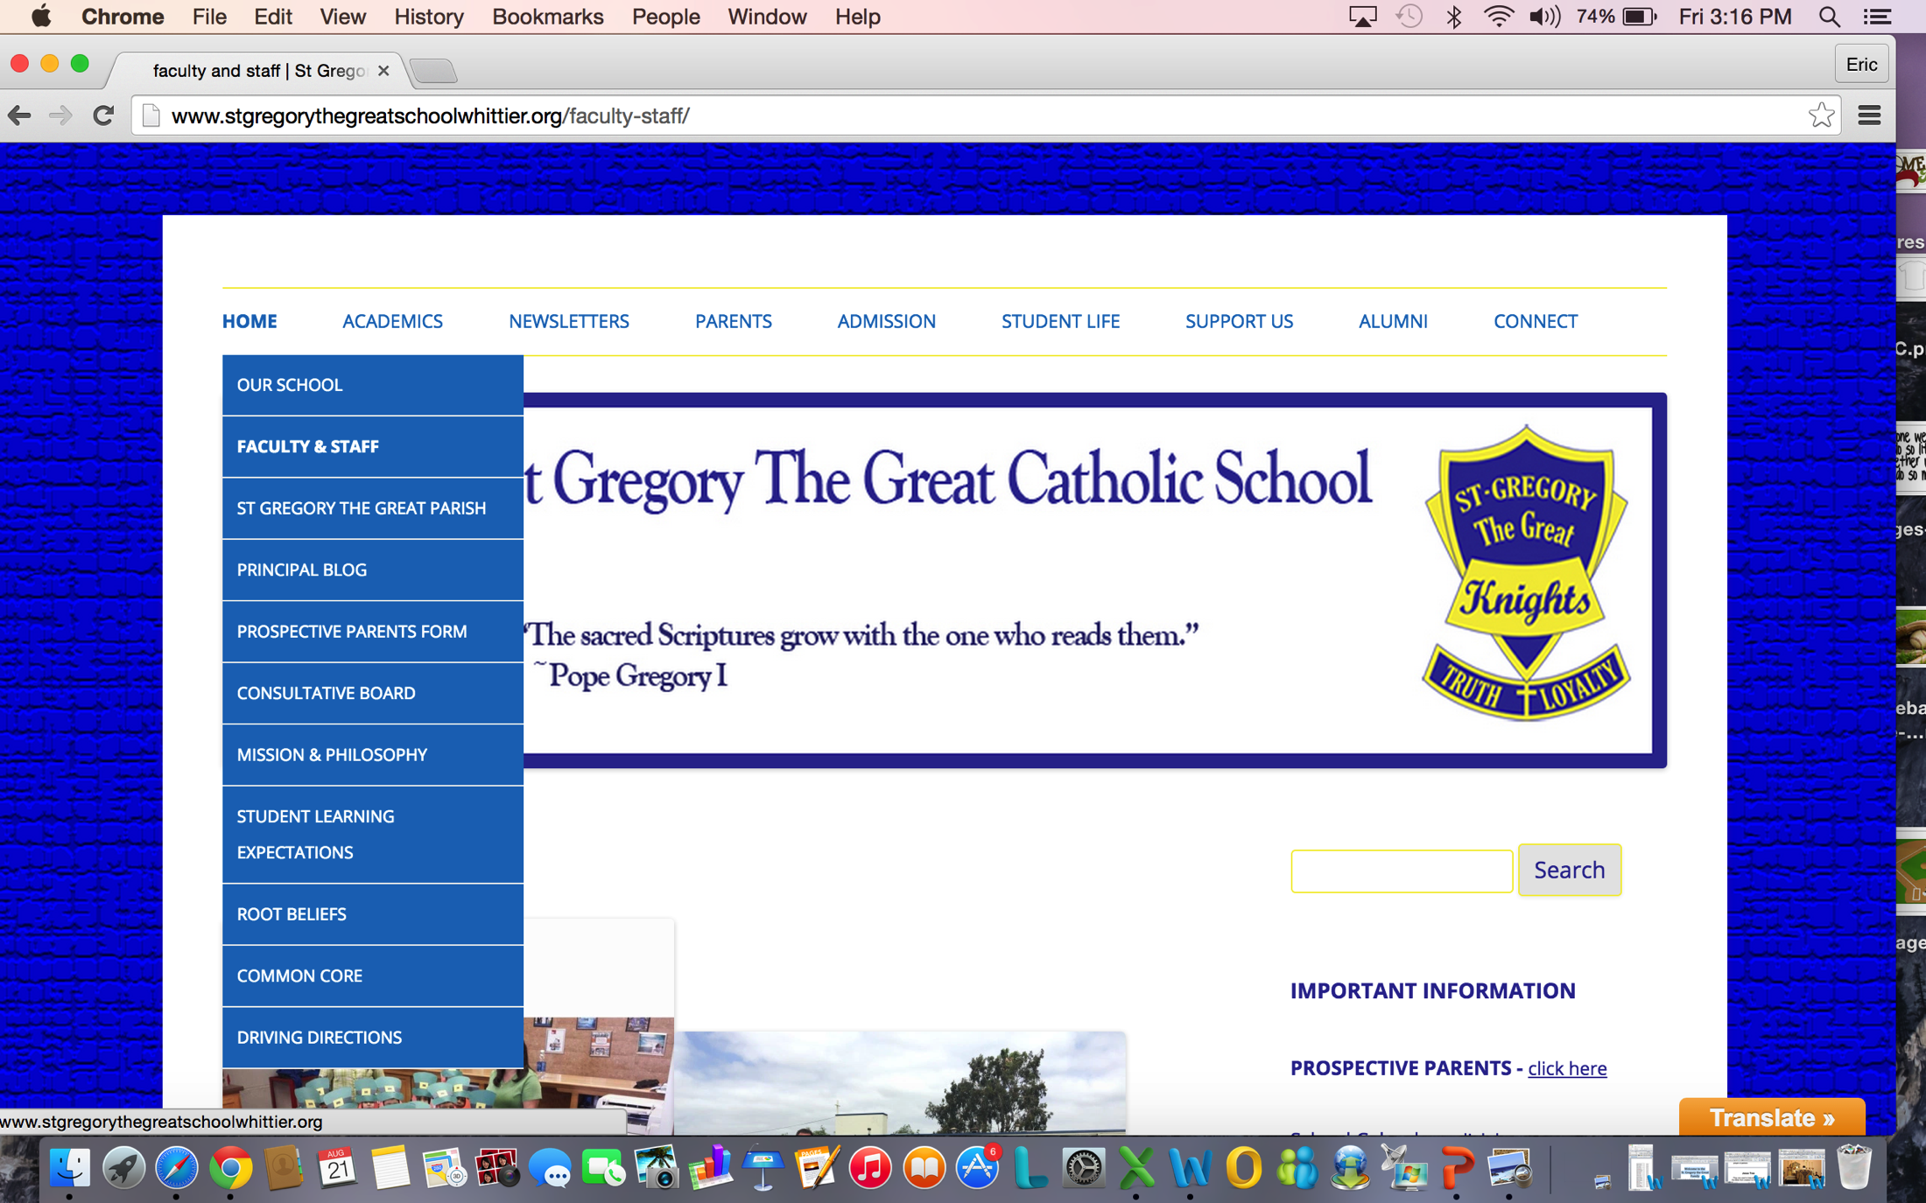
www.sggknights.org
www.stgregorythegreatschoolwhittier.org/

Slide 7
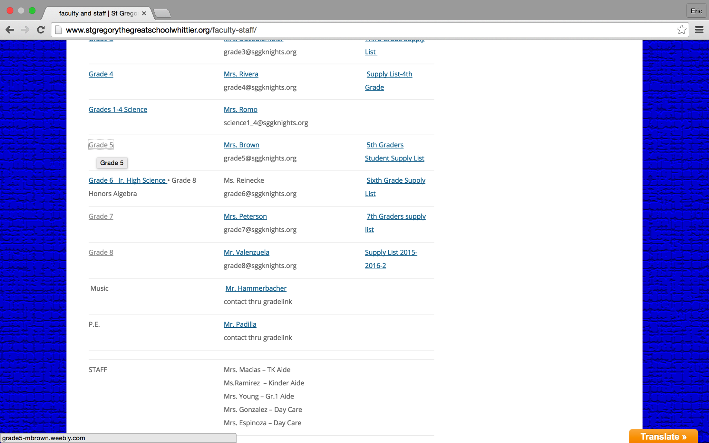

Slide 8
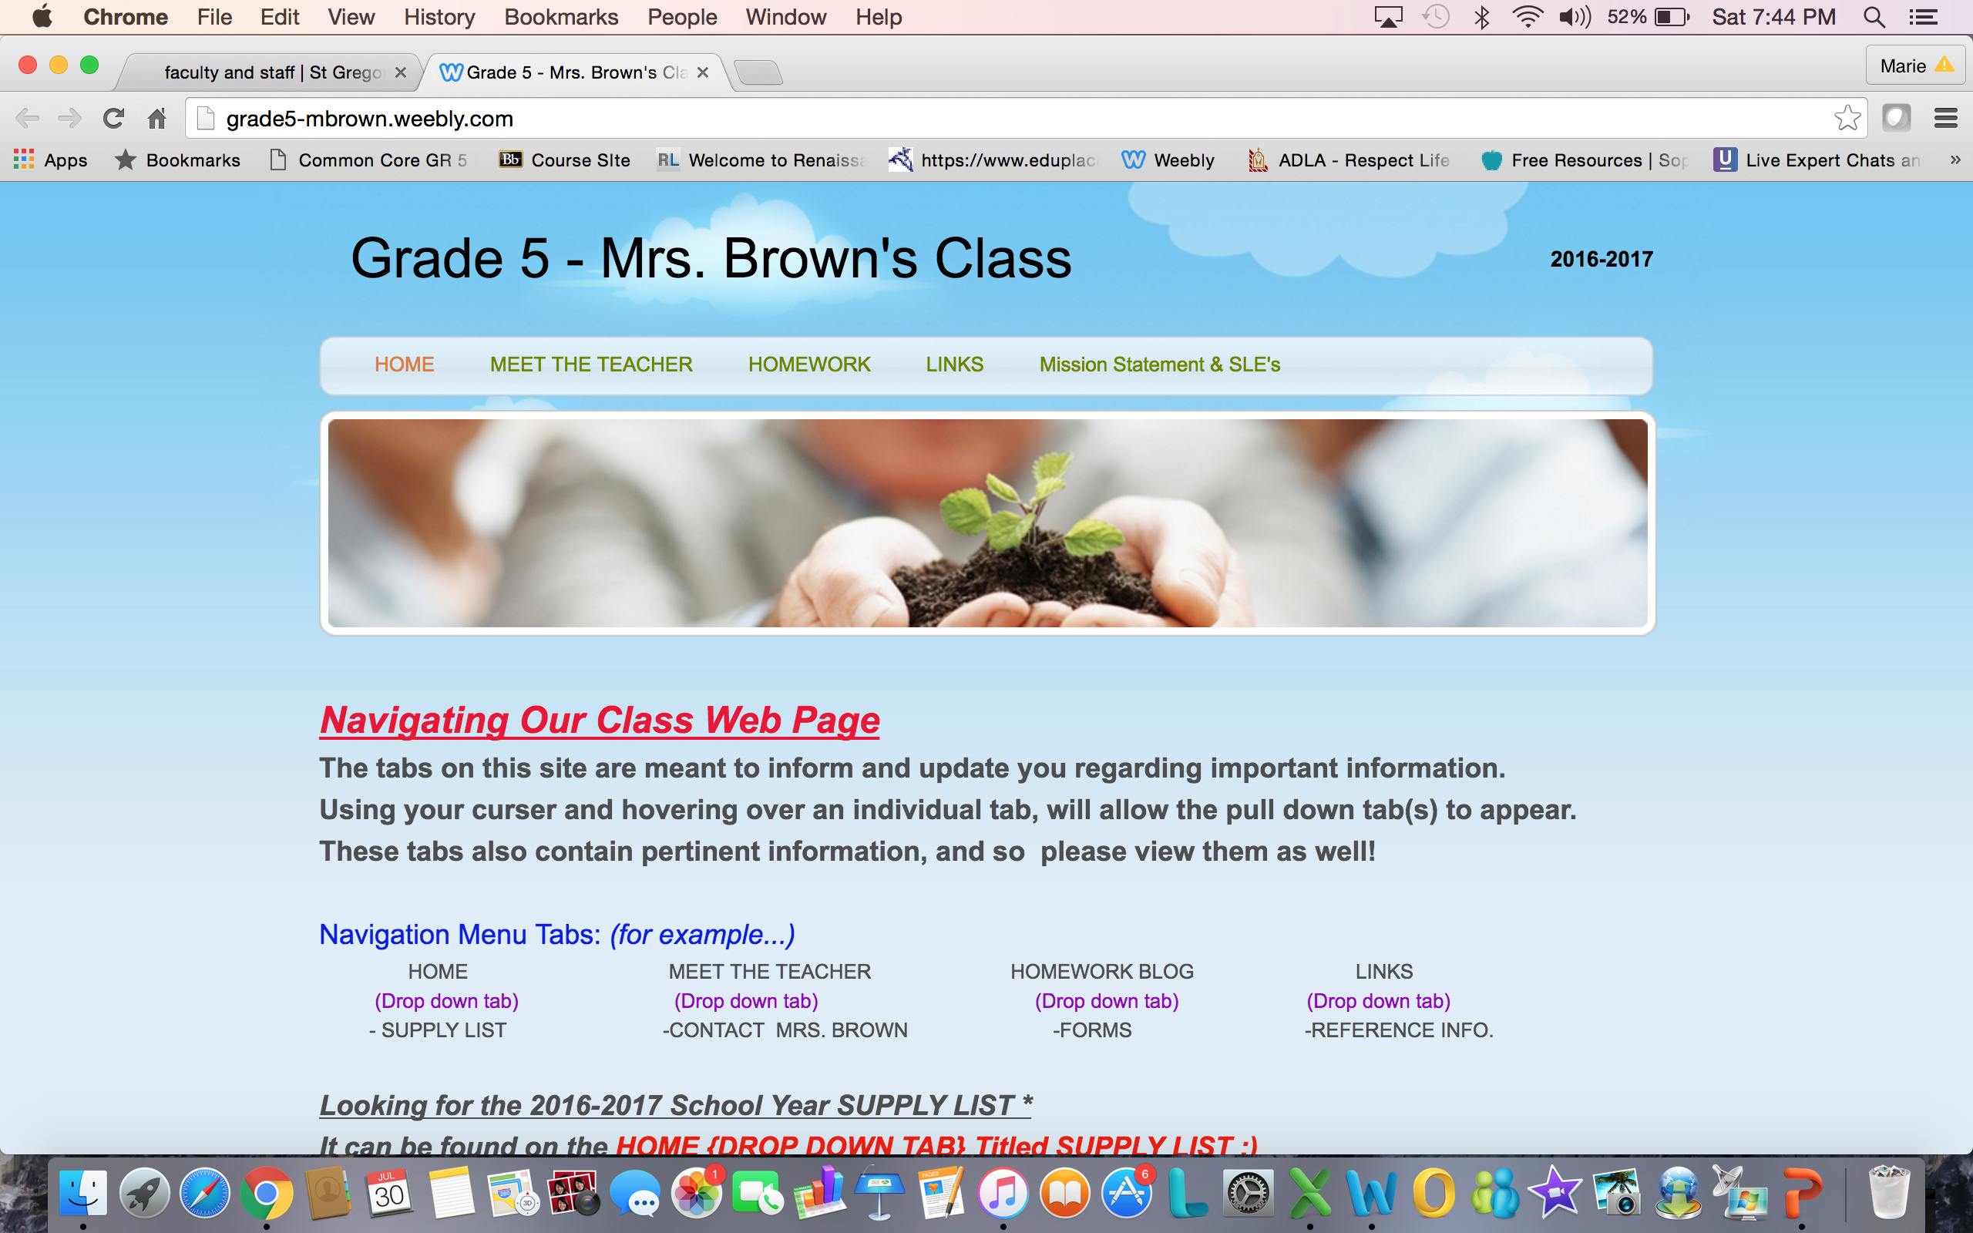
CLASS WEBSITE

Slide 9
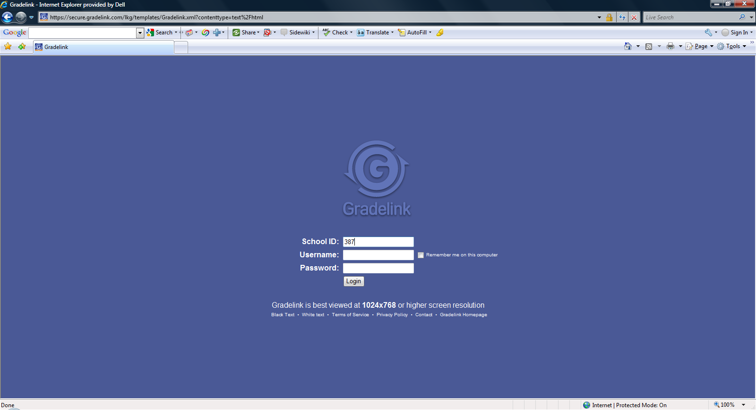
www.gradelink.com
School ID: 387

Slide 10
Room Parent Info
Christine Carrillo
562) 822-7751
Christinelopez1005@gmail.com
Maggie Macias
714) 348-2497
Maggie.macias@gmail.com

Slide 11
Let’s Have a Great Year!
THANK YOU FOR COMING!

